Slide 1
The Central Role of Incentives and Information in Determining the Efficiency of Environmental Regulations
Michael Greenstone
Milton Friedman Professor in Economics and the College
University of Chicago
Director Energy Policy Institute at the University of Chicago

Slide 2
1. Canada Exceeded Kyoto Targets by 25%, So Dropped Out
Canada’s Failure under Kyoto Protocol
Target: 567 Mt CO₂-eq
Actual: 707 Mt CO₂-eq
For reference, Canada’s 1990 emissions was 603 Mt CO₂-eq
Its target for 2012 was a 6% reduction from 1990 levels.
Its actual emissions was a 17% increase.
Source: Environment and Climate Change Canada (2018), Government of Canada
Notes:
Sources for our numbers (not MG’s): https://www.canada.ca/en/environment-climate-change/services/environmental-indicators/greenhouse-gas-emissions.html
Via
https://i0.wp.com/www.easterbrook.ca/steve/wp-content/Canada-Climate-Targets-1.png

Slide 3
2. Poor Compliance with Particulate Matter Regulatory Standards in India
Compliance Limit
Many plants in Gujarat violate the regulatory limit on emissions
Micrograms per Cubic Meter
Source: Duflo et al (2013)

Slide 4
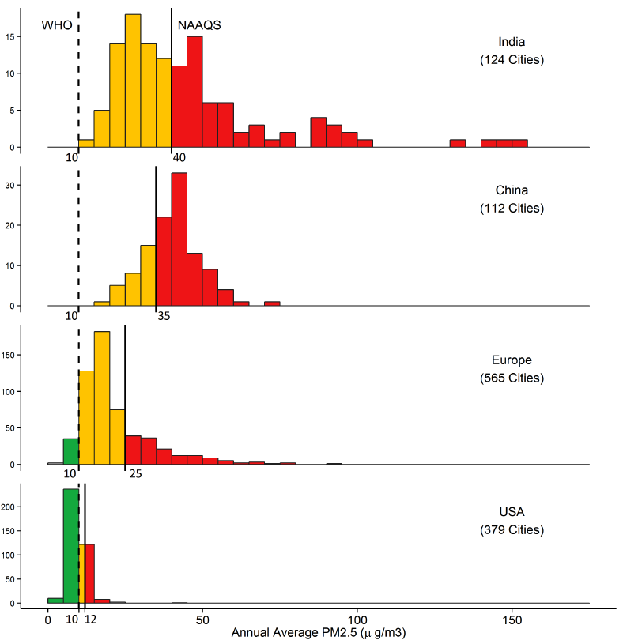
3. Non-Compliance with National Standards is Pervasive

Slide 5
4. In the real world, there is tremendous heterogeneity in regulations’ costs
Cost Effectiveness of Programs that Abated Carbon Emissions
Energy Efficiency Programs
Rebates for appliance upgrade
Rebates for reducing electricity use
Cost per tCO₂ abated ($2016)
Fuel Economy Standards (CAFE)
Rebates for efficient vehicles
Residential weatherization
Cap-and-Trade Initiatives
RGGI
EU ETS
California CaT
U.S. Social Cost of Carbon: $42
Source: Cap-and-trade prices from World Bank as of August 1, 2016.

Slide 6
Overview
Environmental regulations have had substantial benefits
Environmental regulations have had substantial costs
Information & incentives are critical for efficiency
We know a great deal about how to optimally design environmental policy
However, costs and benefits critically depend on information and incentives too and here we know much less. Three promising areas for better implementation:
Aligning incentives to produce desirable outcomes
Exploiting Technology
Leveraging Information Dissemination

Slide 7
Outline
Environmental regulations have had substantial benefits
US
Environmental regulations have had substantial costs
Information & incentives are critical for efficiency

Slide 8
Does Air Quality Matter? Evidence from the Housing Market
Journal of Political Economy, 2005
Kenneth Chay
Michael Greenstone

Slide 9
1970 Clean Air Act Amendments
Used the attainment status assignment from the CAA to estimate a hedonic regression
Goal was to uncover the (marginal) willingness to pay for clean air from housing markets
Results show that people value clean air
WTP for late 1970s reductions in TSPs in non-attainment counties was $123 billion in 2018 dollars

Slide 10
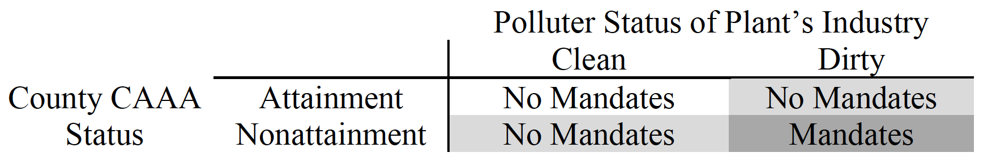
1970 Clean Air Act Amendments
EPA established national ambient air quality standards
CO, O₃, SO₂, and TSPs
County-level variation: Attainment status & emissions caps
Plant-level variation: Specific standards in non-attainment counties

Slide 11
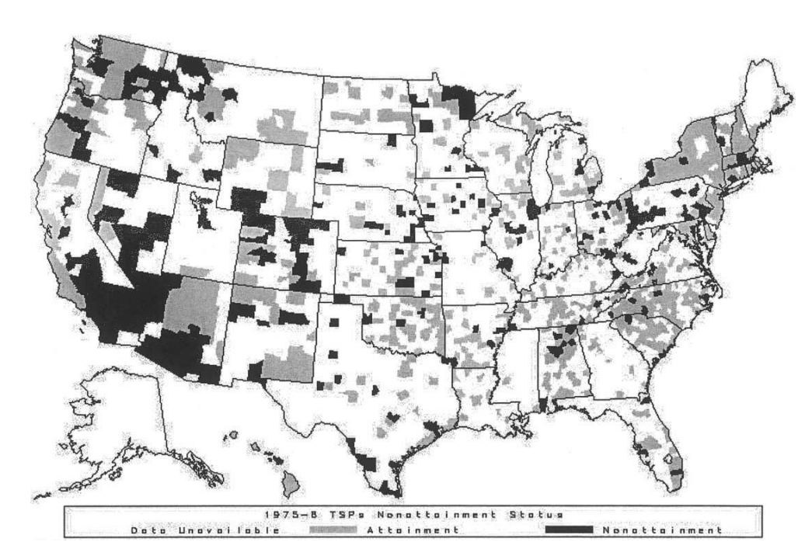
TSPs Attainment Status

Slide 12
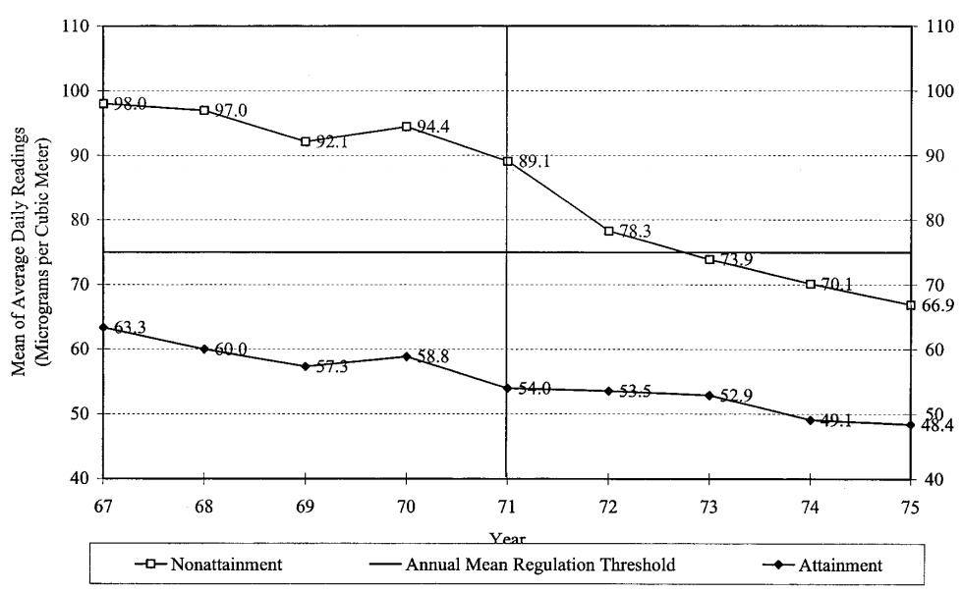
Trends in TSPs by Attainment Status

Slide 13
Empirical Method
Use mid-1970s TSPs regulation from the CAA as an IV Z for TSP T, no direct effect on housing prices y
Structural:
First-Stage:
Definition of instrument:

Slide 14
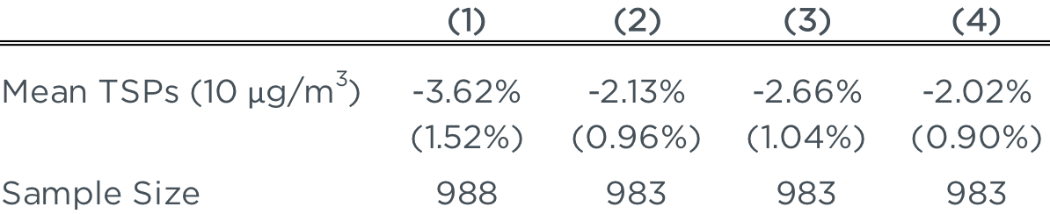
IV Results: TSPs on Log Housing Values
Effect of 1970-1980 Changes in TSPs on Log Housing Prices, using TSPs nonattainment in 1975 or 1976 as an IV
Note: Columns 2-4 include County Data book covariates. Columns 3-4 includes flexible functional forms of county covariates. Column 4 includes region fixed effects. Non-attainment led to a decrease in mean TSPs of around 10 μg/m³, depending on the specification.
Notes:
Table 5, page 411

Slide 15
Summary of Results
Marginal WTP estimate of 0.20% to 0.35% increase in house prices for a 1% decline in TSP concentrations
WTP for late 1970s reductions in TSPs in non-attainment counties was $123 billion in 2018 dollars
Main Takeaway: People valued the pollution declines from the Clean Air Act, likely reflecting health benefits and valuation of improved aesthetics
Notes:
$63 billion in 2001 dollars

Slide 16
Defensive Investments and the Demand for Air Quality: Evidence from the NO_{x} Budget Program
American Economic Review, 2017
Olivier Deschênes
Michael Greenstone
Joseph Shapiro

Slide 17
Defensive Investments
People respond to air pollution by purchasing health investments (e.g. asthma inhalers and purifiers) for protection
In the absence of air pollution, people would re-optimize and not spend as much on defensive investments

Slide 18
Defensive Investments
People respond to air pollution by purchasing health investments (e.g. asthma inhalers and purifiers) for protection
In the absence of air pollution, people would re-optimize and not spend as much on defensive investments
Paper uses spending on defensive investments to smog to uncover the public’s valuation of the air quality improvements from the NO_{x} Budget Program, found benefits of over $10 billion over 5 years in 2017 dollars

Slide 19
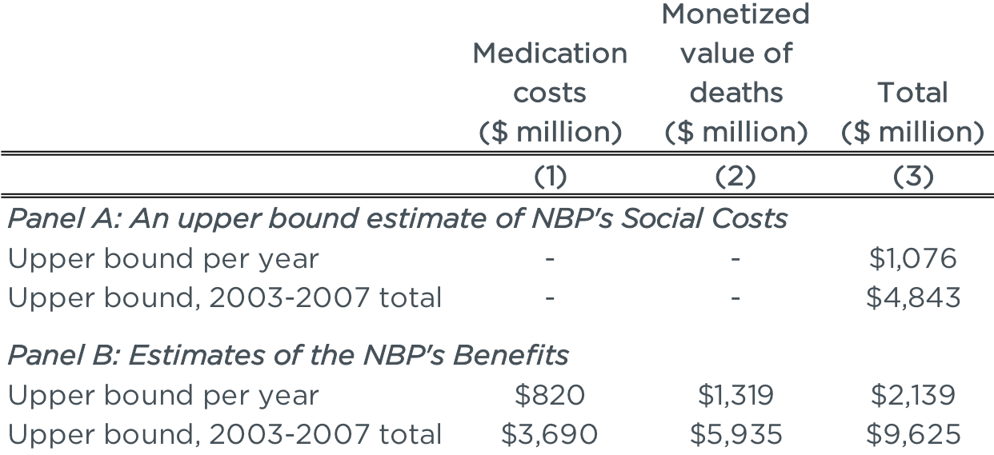
Results
Welfare Impacts of the NBP and Social Benefits of NO_{x} and Ozone Reductions

Slide 20
Outline
Environmental regulations have had substantial benefits
US
China
Environmental regulations have had substantial costs
Information & incentives are critical for efficiency

Slide 21
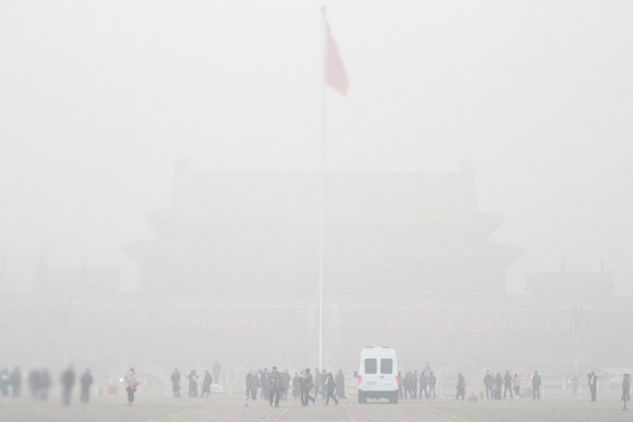
Notes:
A sneak peak of the thick pan cover. A picture of the famous Tiananmen gate taken by a tourist standing on the Tiananmen Square in “broad daylight.”

Slide 22
The Impact of Sustained Exposure To Particulate Matter on Life Expectancy: New Evidence From China’s Huai River Policy
Proceedings of the National Academy of Sciences, 2017
Avraham Ebenstein
Maoyong Fan
Michael Greenstone
Guojun He
Maigeng Zhou

Slide 23
China’s Huai River Winter Heating Policy
Goal is to estimate the mortality effects of long-term sustained levels of pollution
Use the Chinese government policy of providing free coal for small boilers, during the winter, for households north of the Huai River, but not south of the river due to budget limitations
Established in 1950-80s, during the planning period
Resulted in exogenously higher pollution levels north of the Huai River, which we can use to estimate the effect of pollution on long-run outcomes

Slide 24
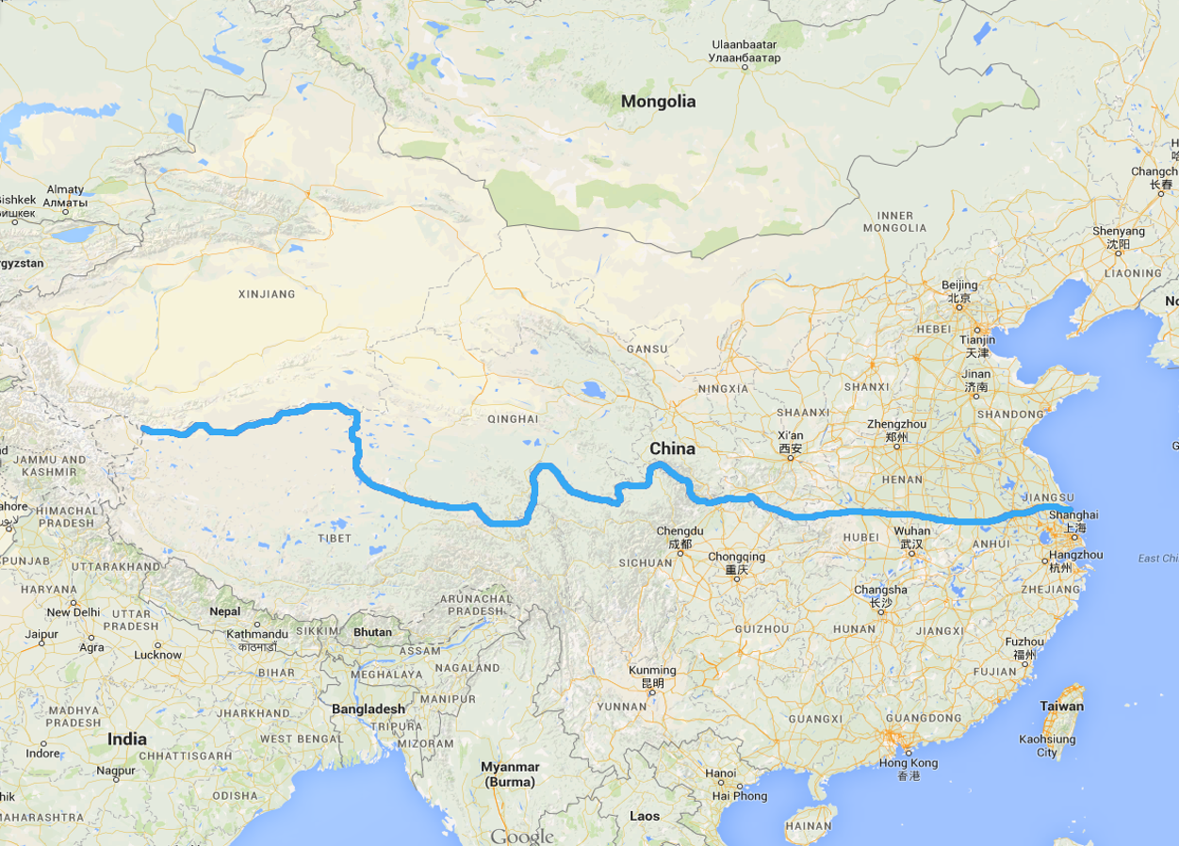
The Dividing Line
The Huai River forms the dividing line between regions with heavy coal-fired home heating and regions with little to no use of such boilers.

Slide 25
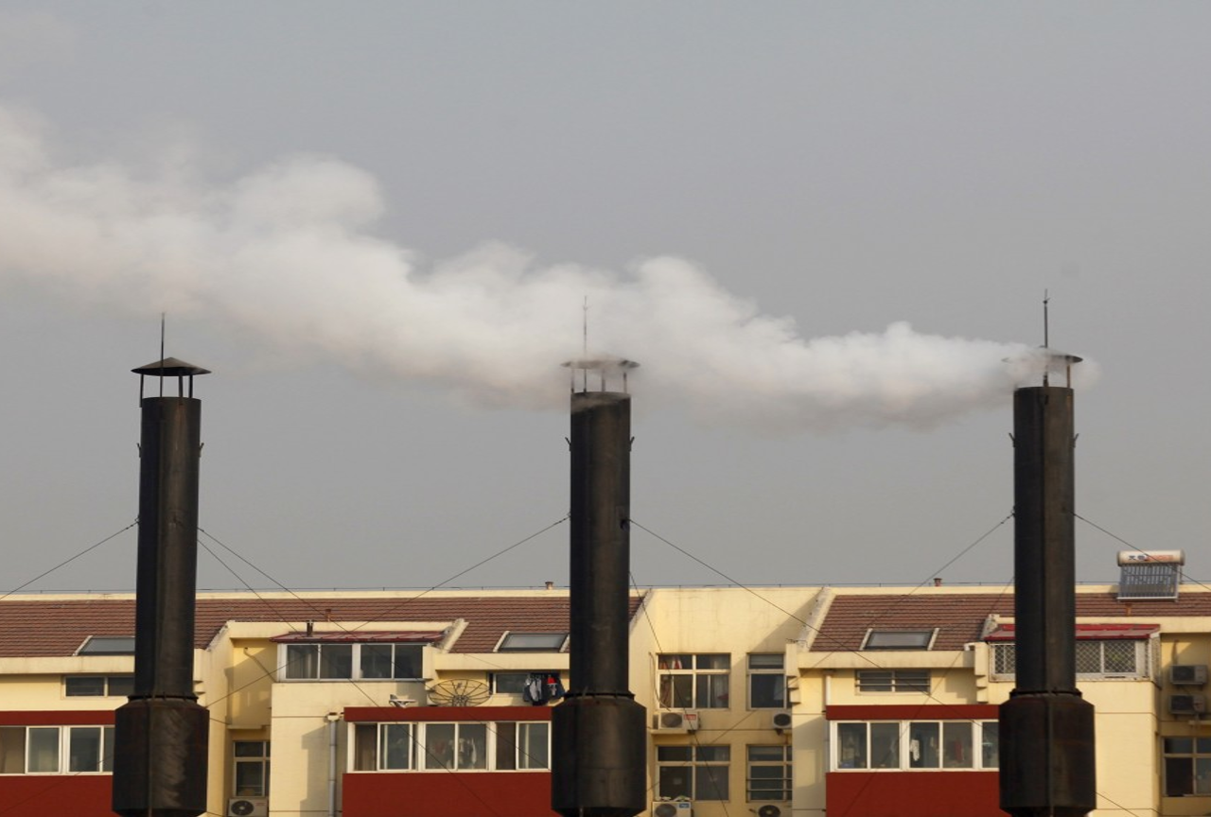
The Boiler Heating System
Subsidized coal is burned to heat water, often in a boiler housed in a building. The combusted coal emits high levels of soot and particulate matter.

Slide 26
PM₁₀ Concentrations, by Distance from Huai River

Slide 27
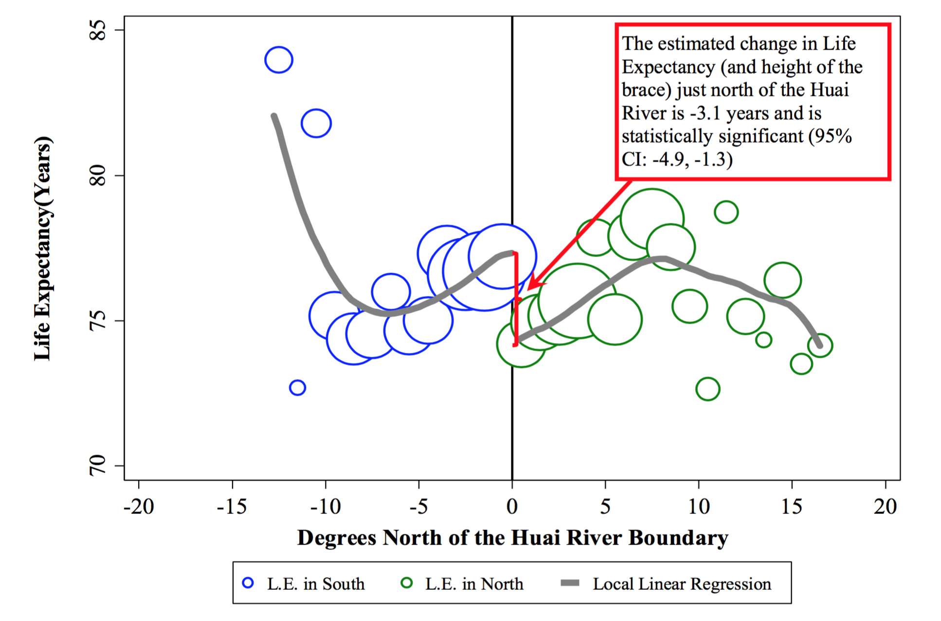
Life Expectancy, by Distance from Huai River

Slide 28
Local Linear IV Estimates of the Effect of PM₁₀ on Life Expectancy
Notes:
Patrick verified that the fact that columns 1 and 2 are the same is indeed true from the regression results

Slide 29
Conclusions
A 10-μg/m³ increase in PM₁₀ reduces life expectancy by 0.64 years
Regulation that would bring China into compliance with its Class I standards could save 3.7 billion life-years
Findings can be generalized to the 4.5+ billion people around the world who live in areas with pollution concentrations beyond twice the WHO standard

Slide 30
Outline
Environmental regulations have had substantial benefits
US
China
World
Environmental regulations have had substantial costs
Information & incentives are critical for efficiency

Slide 31
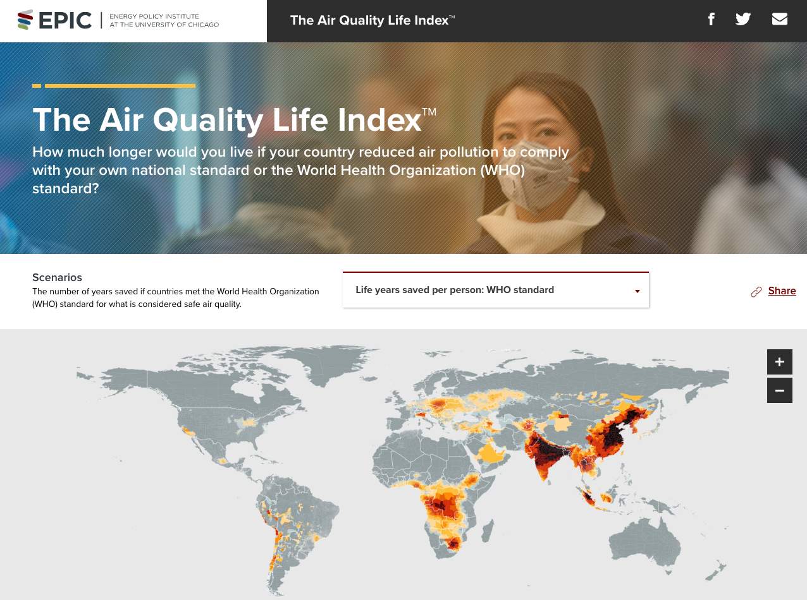
Notes:
Version 1

Slide 32
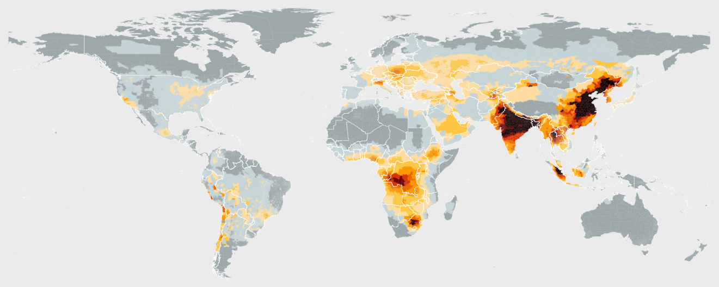

Global concentrations of PM_{2.5}
Source: AQLI, available at https://aqli.epic.uchicago.edu.

Slide 33
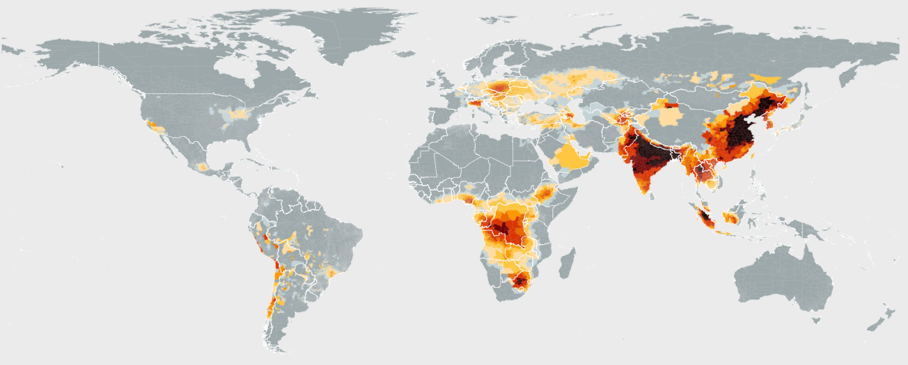
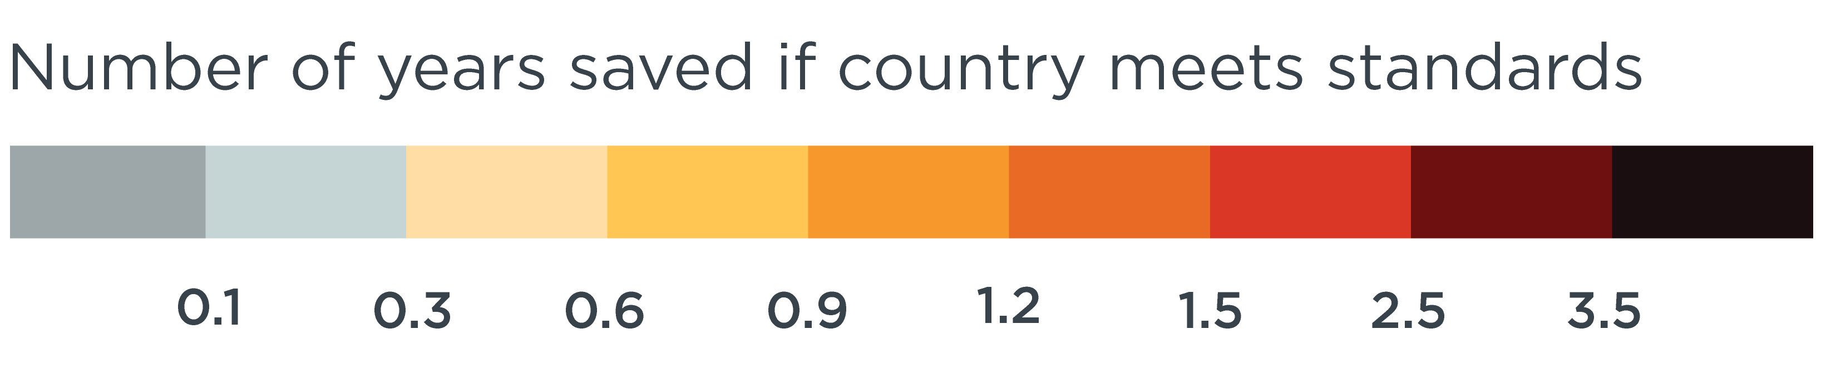
Projected Increase in Life Expectancy if Air Pollution Met WHO Standards
Source: AQLI, available at https://aqli.epic.uchicago.edu.

Slide 34
Benefits – Growing Literature
Air Pollution
Water Pollution
Worker Productivity
Impacts on Human Capital Formation

Slide 35
Outline
Environmental regulations have had substantial benefits
Environmental regulations have had substantial costs
Information & incentives are critical for efficiency

Slide 36
Regulations Impose Costs on Firms
In theory, regulations reduce productivity and output by forcing plants to shift resources towards nonproductive pollution abatement
Several papers demonstrate that regulations impose large costs on industry around the world

Slide 37
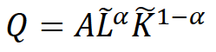
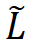
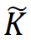
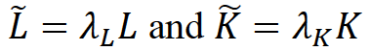
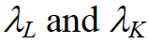
Model of Regulatory Costs
From Greenstone, List, Syverson (2012):
Plants have a production function
where and are production-effective labor and capital, related to observed labor L and observed capital K by
The and capture the notion that regulatory mandates require inputs, e.g. scrubbers, that are not directly useful for production

Slide 38
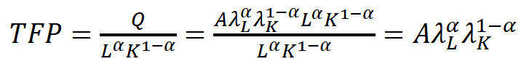
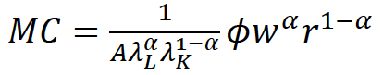
Model of Regulatory Costs
From Greenstone, List, Syverson (2012):
Solving for total factor productivity,
Solving for the marginal cost,
More stringent regulations reduce the lambda values, reduce TFP, and raise MC

Slide 39
Outline
Environmental regulations have had substantial benefits
Environmental regulations have had substantial costs
US Clean Air Act
Information & incentives are critical for efficiency

Slide 40
The Impacts of Environmental Regulations on Industrial Activity: Evidence from the 1970 and 1977 Clean Air Act Amendments and the Census of Manufactures
Journal of Political Economy, 2002
Michael Greenstone

Slide 41
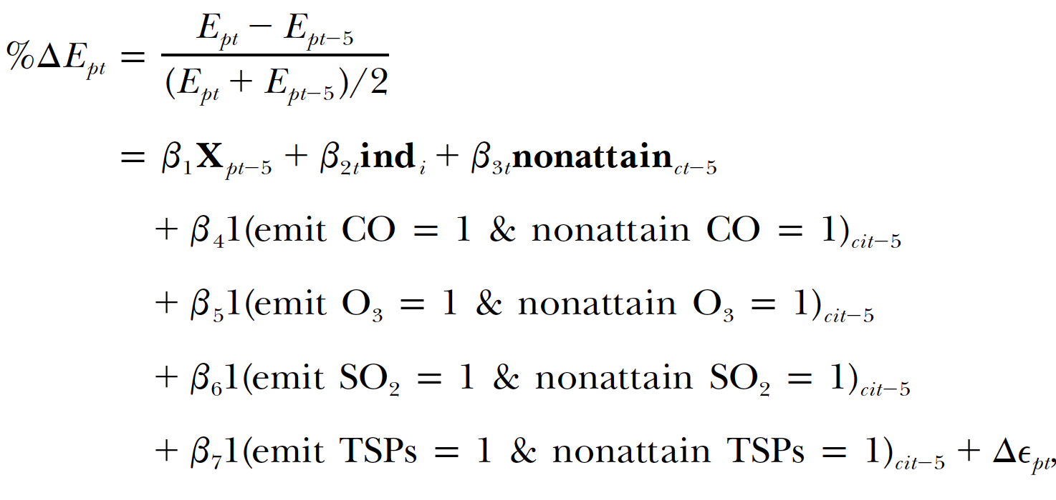
Methodology
Compare growth in employment, capital stock, and shipments among polluting plants in attainment vs. non-attainment counties based on the Clean Air Act

Slide 42
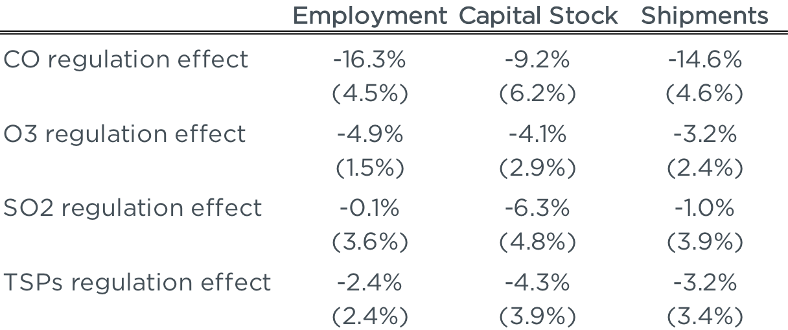
Impact of regulation: Employment
Change in employment five years after non-attainment designation
Note: The regressions include industry-period, county-period, and plant fixed effects.
Notes:
Table 5, Page 1199

Slide 43
Conclusions
Compared to attainment counties, pollution intensive industries in non-attainment counties lost:
590,000 jobs
$79 billion in capital stock
$162 billion of output
Notes:
Originally $37B and $75B in 1987 dollars, inflated using CPI-U. Note that all numbers are adjusted to 2017 dollars

Slide 44
Effects of Environmental Regulation on the Competitiveness of US Manufacturing
Michael Greenstone
John List
Chad Syverson

Slide 45
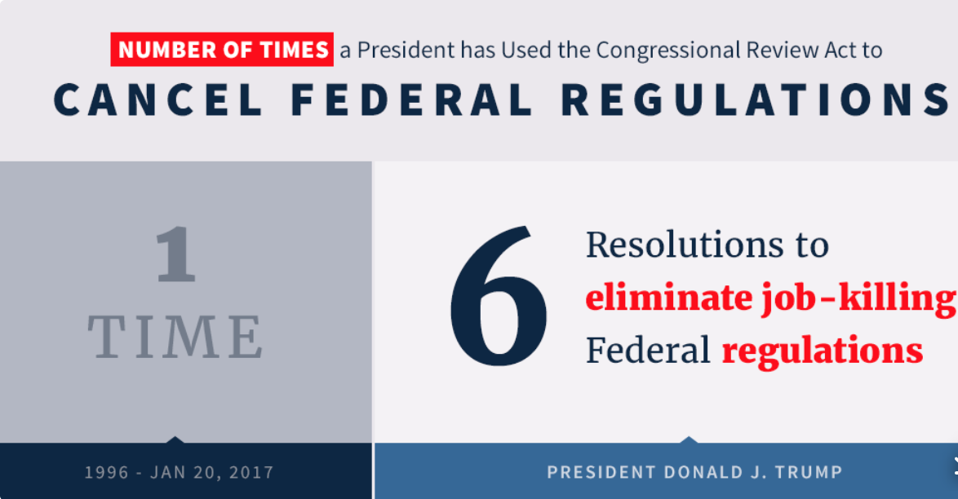
Background
Decline in US manufacturing employment from 18 million in 1970 to 12 million, from 25% to 9% of all employment
How culpable were environmental regulations?

Slide 46
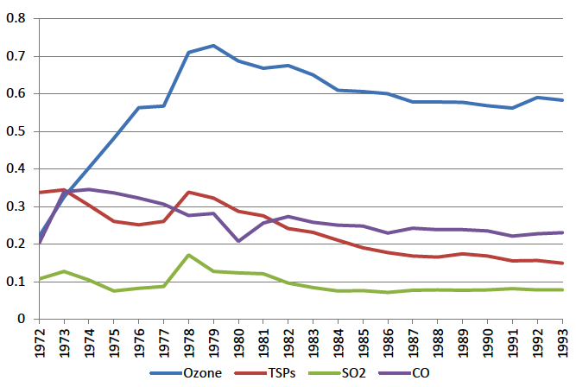
Share of Polluting Industries’ Output Produced in Nonattainment Counties by Pollutant
Notes:
Figure 1, Page 42

Slide 47
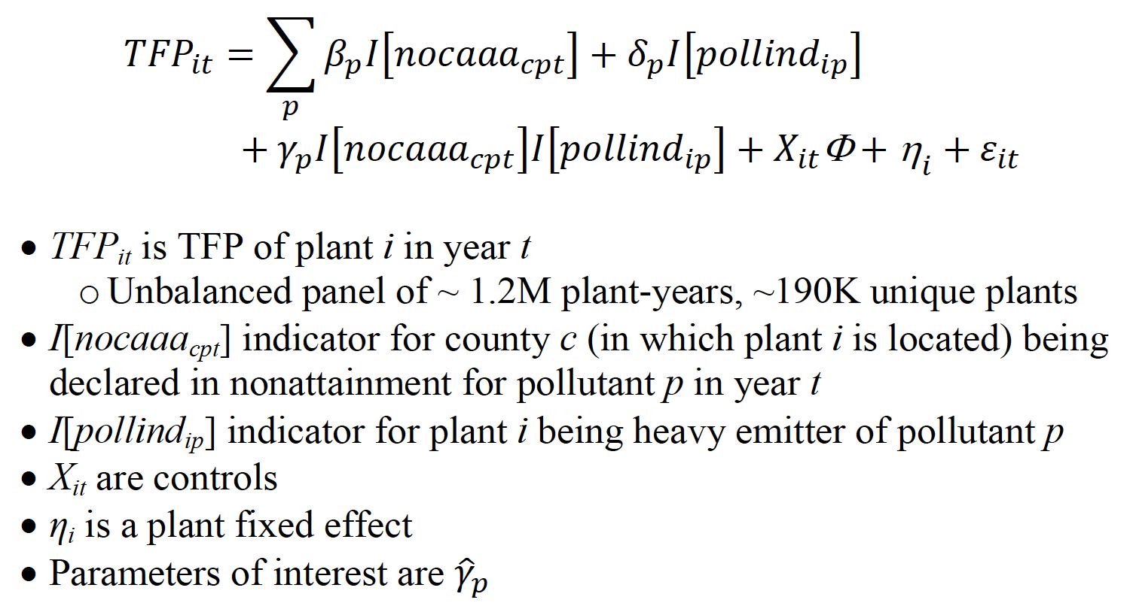
Methodology

Slide 48
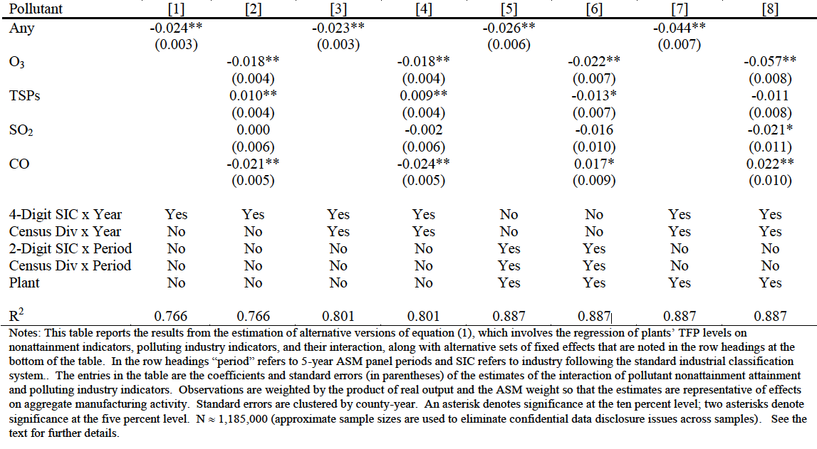
TFP Effects of Nonattainment
Note: All specifications include plant fixed effects. Columns 5 and 6 include 2-digit SIC by period fixed effects as well as census division by period fixed effects. Columns 7 and 8 include 4-digit SIC by year fixed effects as well as census division by year fixed effects.
Notes:
Table 3, Page 45.
“Period” seems to refer to 5-year ASM panel periods

Slide 49
Findings
Non-attainment status from the Clean Air Act associated with 2.6%-4.4% decline in TFP in surviving firms
Estimate likely biased towards zero due to 10% higher exit probability in nonattainment counties among polluting plants
TFP measured using revenue instead of quantity, but environmental regulations likely increase prices
Annual economic cost in 2017 dollars, after corrections for underestimation: $24 billion
Notes:
Paper amount is $21 billion in 2010 dollars.

Slide 50
Outline
Environmental regulations have had substantial benefits
Environmental regulations have had substantial costs
US Clean Air Act
China Emissions Fees
Information & incentives are critical for efficiency

Slide 51
Pollution Mitigation and Productivity: Evidence from Chinese Manufacturing Firms
In Progress
Gautam Gowrisankaran
Michael Greenstone
Ali Hortaçsu
Mengdi Liu
Caixia Shen

Slide 52
Overview
Goal: Quantify the productivity and distributional costs of emissions fees on manufacturing firms in China
Fees imposed on SO₂, NO_{x}, chemical oxygen demand (COD), and nitrogen-ammonia (NH₃-N)
Substantial variation over time and across provinces,
Primary focus is on a set of fee rises in 2010 in some provinces but not others

Slide 53
Methodology
Control for region-year and firm effects
Compare border prefectures across pairs of provinces where one raises fees and the other does not, similar to Dube, Lester, Reich (2010)
In the future, will replace with bandwidths around provincial borders of N km once we obtain accurately geocoded locations of plants
Notes:
https://www.mitpressjournals.org/doi/pdf/10.1162/REST_a_00039

Slide 54
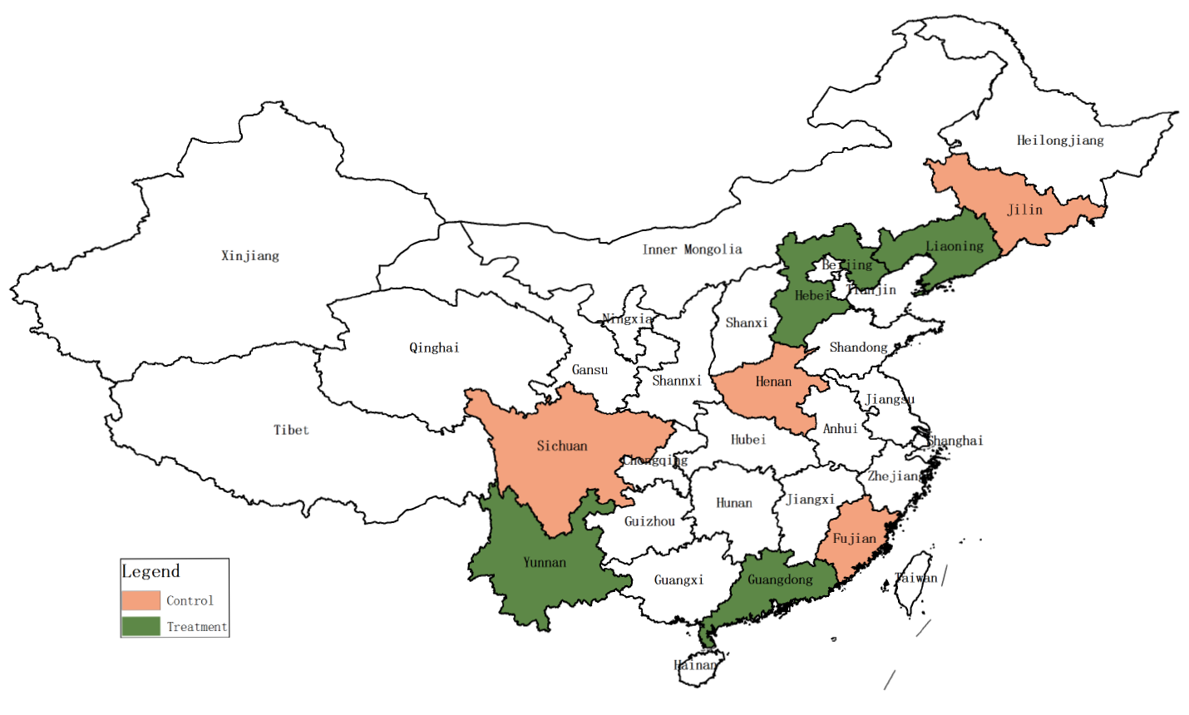
Methodology – Water Discharge Fees
Notes:
https://www.mitpressjournals.org/doi/pdf/10.1162/REST_a_00039

Slide 55
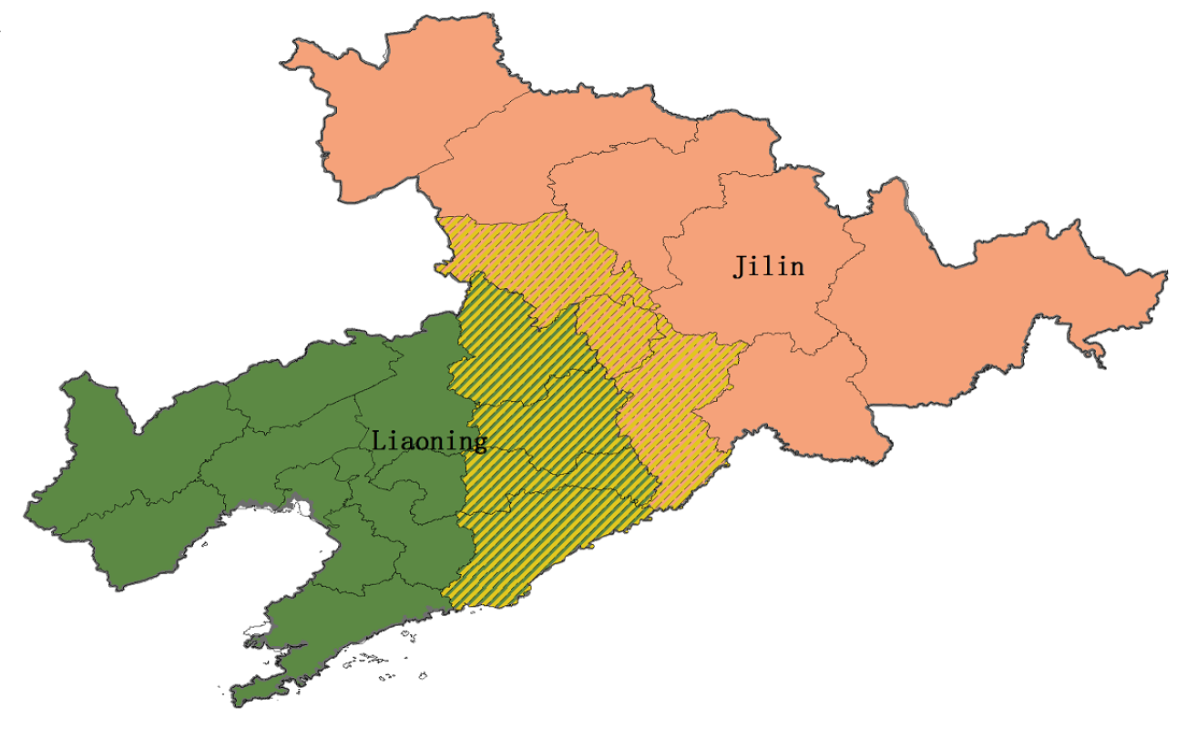
Methodology – Water Discharge Fees
Notes:
https://www.mitpressjournals.org/doi/pdf/10.1162/REST_a_00039

Slide 56
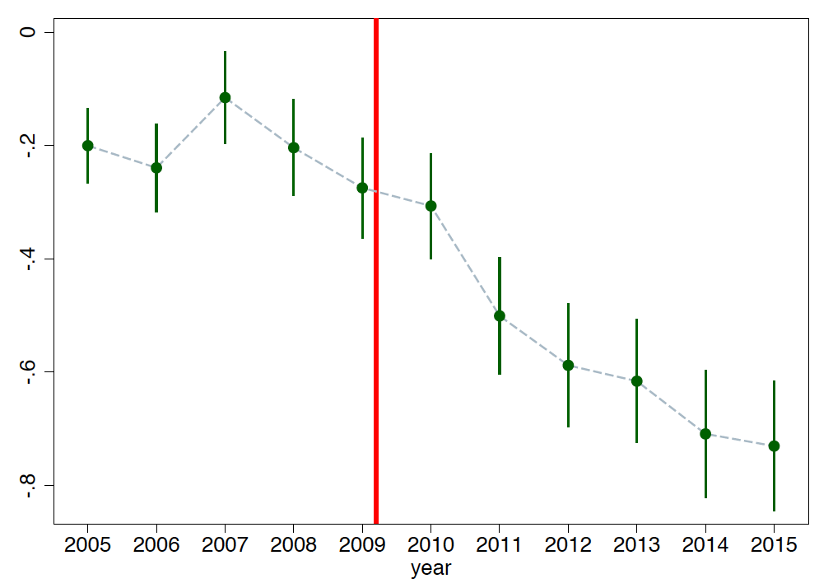
Initial Results: Log SO₂ by year
Note: The y-axis is coefficients of SO₂ year FEs, treatment vs control
Notes:
All numbers come from the “border effects” slides, with the FE specification (generally col 2), from the April 2018 talk.
SO2 on Fees: slide 30 (graph on 31)

Slide 57
Initial Results: Log NO_{x} by year
Note: The y-axis is coefficients of NO_{x} year FEs, treatment vs control
Notes:
All numbers come from the “border effects” slides, with the FE specification (generally col 2), from the April 2018 talk.
SO2 on Fees: slide 30 (graph on 31)

Slide 58
Initial Results: Border SO₂ Fees Pollution Levels
Note: All regressions include year FEs, firm FEs, and region-year interactions.
Notes:
All numbers come from the “border effects” slides, with the FE specification (generally col 2), from the April 2018 talk.
Output on Fees: slide 54 (graph on 51)

Slide 59
Initial Results: Border Impact on Output for SO₂ Fees
Note: All regressions control for the firms’ log capital and log number of workers. All regressions include regional FEs, year FEs, firm FEs, and region-year interactions.

Slide 60
Magnitudes of Preliminary Results
Doubling of fees led to 10-20% drop in pollution
Productivity cost from doubling fees:
Air: 11.5 percent decline in productivity
Water: 7.2 percent decline in productivity
Notes:
Slide 65

Slide 61
Regulatory Costs – Other Work
Ryan (2012) – Regulations increase losses due sunk cost of entry in industries with large fixed costs
Walker (2013) – Workers reallocated due to environmental regulations incur substantial transitional costs
Fowlie, Reguant, and Ryan (2016) – Regulations in imperfectly competitive industries exacerbate market power distortions and encourage emissions “leakage”
Shapiro and Walker (2018) – However, regulations have been successful in reducing emissions intensity of manufacturing

Slide 62
Outline
Environmental regulations have had substantial benefits
Environmental regulations have had substantial costs
Information & incentives are critical for efficiency

Slide 63
Evolution of the Theory of Environmental Regulatory Enforcement
Becker Model of Crime: Assumes that crime (or in our setting environmental violations) are a function of the probability of detection and the fines – penalties and costs determine everything
Notes:
Potential citations for part 3 (institutions as destiny in env regs):
Fredriksson, Per G., and Jakob Svensson. "Political instability, corruption and policy formation: the case of environmental policy." Journal of Public Economics 87, no. 7-8 (2003): 1383-1405.
Congleton, Roger D. "Political institutions and pollution control." The review of economics and statistics (1992): 412-421.
Greenstone, Michael, and Rema Hanna. "Environmental regulations, air and water pollution, and infant mortality in India." American Economic Review 104, no. 10 (2014): 3038-72.

Slide 64
Evolution of the Theory of Environmental Regulatory Enforcement
Becker Model of Crime: Assumes that crime (or in our setting environmental violations) are a function of the probability of detection and the fines – penalties and costs determine everything
Information Economics Revolution (e.g., Laffont and Tirole 1993): Model as a principal (regulator) – agent (polluter) problem where common knowledge is a bad assumption
Detection is not just a choice variable for government
Information, including false information, is the most precious commodity in this interaction
Strategic impacts of specific regulatory rules
Notes:
Potential citations for part 3 (institutions as destiny in env regs):
Fredriksson, Per G., and Jakob Svensson. "Political instability, corruption and policy formation: the case of environmental policy." Journal of Public Economics 87, no. 7-8 (2003): 1383-1405.
Congleton, Roger D. "Political institutions and pollution control." The review of economics and statistics (1992): 412-421.
Greenstone, Michael, and Rema Hanna. "Environmental regulations, air and water pollution, and infant mortality in India." American Economic Review 104, no. 10 (2014): 3038-72.

Slide 65
Evolution of the Theory of Environmental Regulatory Enforcement
Becker Model of Crime: Assumes that crime (or in our setting environmental violations) are a function of the probability of detection and the fines – penalties and costs determine everything
Information Economics Revolution (e.g., Laffont and Tirole 1993): Model as a principal (regulator) – agent (polluter) problem where common knowledge is a bad assumption
Detection is not just a choice variable for government
Information, including false information, is the most precious commodity in this interaction
Strategic impacts of specific regulatory rules
→ How can Efficient Environmental Regulations be Designed, Particularly in the Presence of Weak Institutions?
Notes:
Potential citations for part 3 (institutions as destiny in env regs):
Fredriksson, Per G., and Jakob Svensson. "Political instability, corruption and policy formation: the case of environmental policy." Journal of Public Economics 87, no. 7-8 (2003): 1383-1405.
Congleton, Roger D. "Political institutions and pollution control." The review of economics and statistics (1992): 412-421.
Greenstone, Michael, and Rema Hanna. "Environmental regulations, air and water pollution, and infant mortality in India." American Economic Review 104, no. 10 (2014): 3038-72.

Slide 66
But even with “good” regulations on the books, how can things go wrong?
Regulatory enforcement of environmental regulations often regarded as a black box, with the focus on the potential costs & benefits
Information and incentive problems can drive large gaps between the actual and expected impacts of regulation. This is because the realized values of the costs and benefits are endogenous to the form and effectiveness of enforcement
Optimal policy can draw on insights from organizational economics, industrial economics, and political economy

Slide 67
But even with “good” regulations on the books, how can things go wrong?
Low rate of punishment given inspection
Low probability of inspection
Small expectation of value of punishment
Inspections badly targeted, corruption, accurate information is costly, etc.
Few incentives to comply

Slide 68
Enforcement Matters
“I must emphasize that standards are not enough. They must also be enforced which is often difficult...”
- Former Indian PM Manmohan Singh, Delhi Sustainable Development Summit, 2011

Slide 69
Outline
Environmental regulations have had substantial benefits
Environmental regulations have had substantial costs
Information & incentives are critical for efficiency
Incentivizing the Delivery of Reliable Information to Regulators
The Benefits of Regulatory Discretion
Targeting Inspections
The MIT Solution – “Technology”
Leveraging Citizen Engagement

Slide 70
Truth-telling by Third-party Auditors and the Response of Polluting Firms: Experimental Evidence from India
The Quarterly Journal of Economics, 2013
Esther Duflo
Michael Greenstone
Rohini Pande
Nicholas Ryan

Slide 71
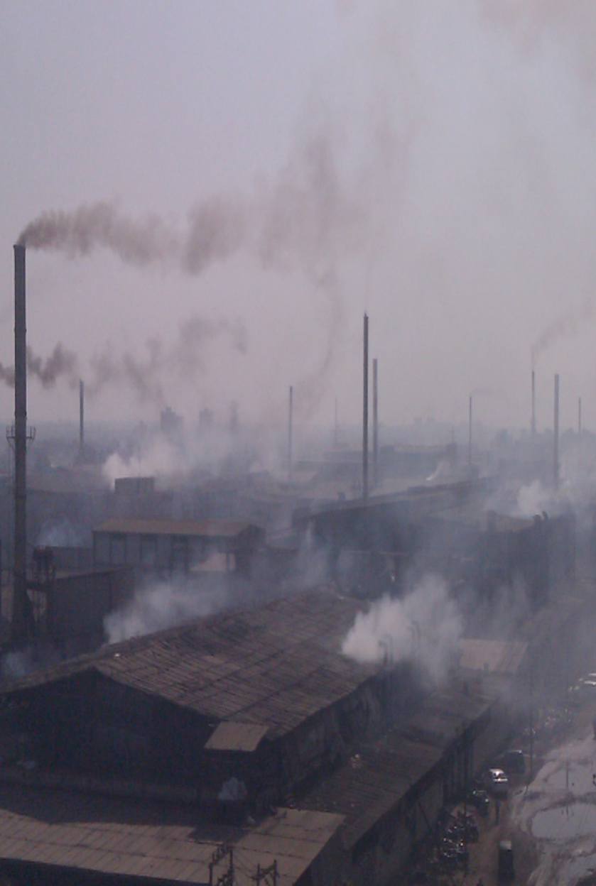
Case Study: An Experiment to Improve Environmental Regulation in Gujarat
Gujarat is the most industrialized state in India and among its most heavily polluted. The Gujarat Pollution Control Board regulates more than 20,000 industrial plants using third-party audits.

Slide 72
The Policy Status Quo
India has strict environmental laws on the books
Yet, pollution levels are high
Gujarat uses third-party audits to enforce environmental regulations
Polluters select and pay their auditors
Working with the Gujarat Pollution Control Board, we designed an intervention to break this conflict of interest
We divided plants into a control group and a treatment group
The control group continued the status quo approach to audits
In the treatment group, polluters paid into a central fund, which randomly assigned auditors to the plants

Slide 73
Final-outlet water and boiler-stack air samples
Water Sampling
Stack Sampling

Slide 74
Getting a Better Pollution Audit
Audit Readings for Suspended Particulate Matter
Compliance Limit
Most plants reported to be in compliance under the status quo auditing system
Micrograms per Cubic Meter
Source: Duflo et al (2013)

Slide 75
Getting a Better Pollution Audit
Audit Readings for Suspended Particulate Matter
Compliance Limit
Result One: reporting was corrupt in the status quo
Our back checks uncovered many more violators than the status quo audits did
Micrograms per Cubic Meter
Source: Duflo et al (2013)

Slide 76
Getting a Better Pollution Audit
Audit Readings for Suspended Particulate Matter
Compliance Limit
Treatment auditors reported a much wider range of emissions.
Micrograms per Cubic Meter
Source: Duflo et al (2013)

Slide 77
Getting a Better Pollution Audit
Audit Readings for Suspended Particulate Matter
Compliance Limit
Result Two: the treatment caused the auditors to become more truthful
Micrograms per Cubic Meter
Source: Duflo et al (2013)

Slide 78
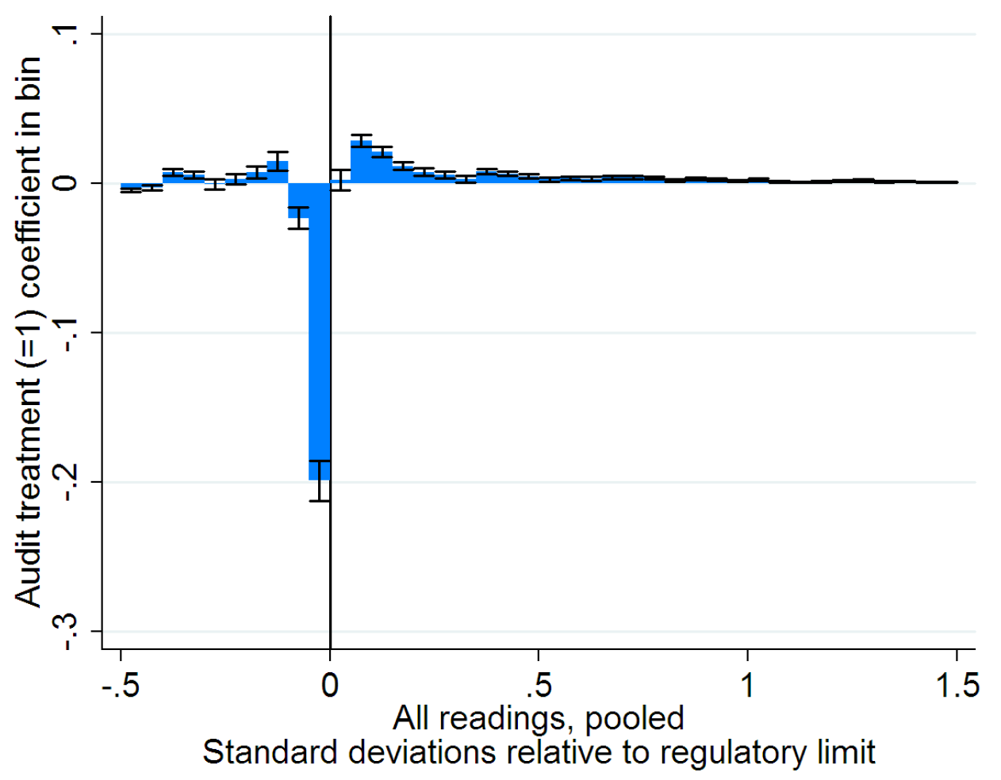
Getting a Better Pollution Audit
Another way of seeing the significant auditor treatment bias

Slide 79
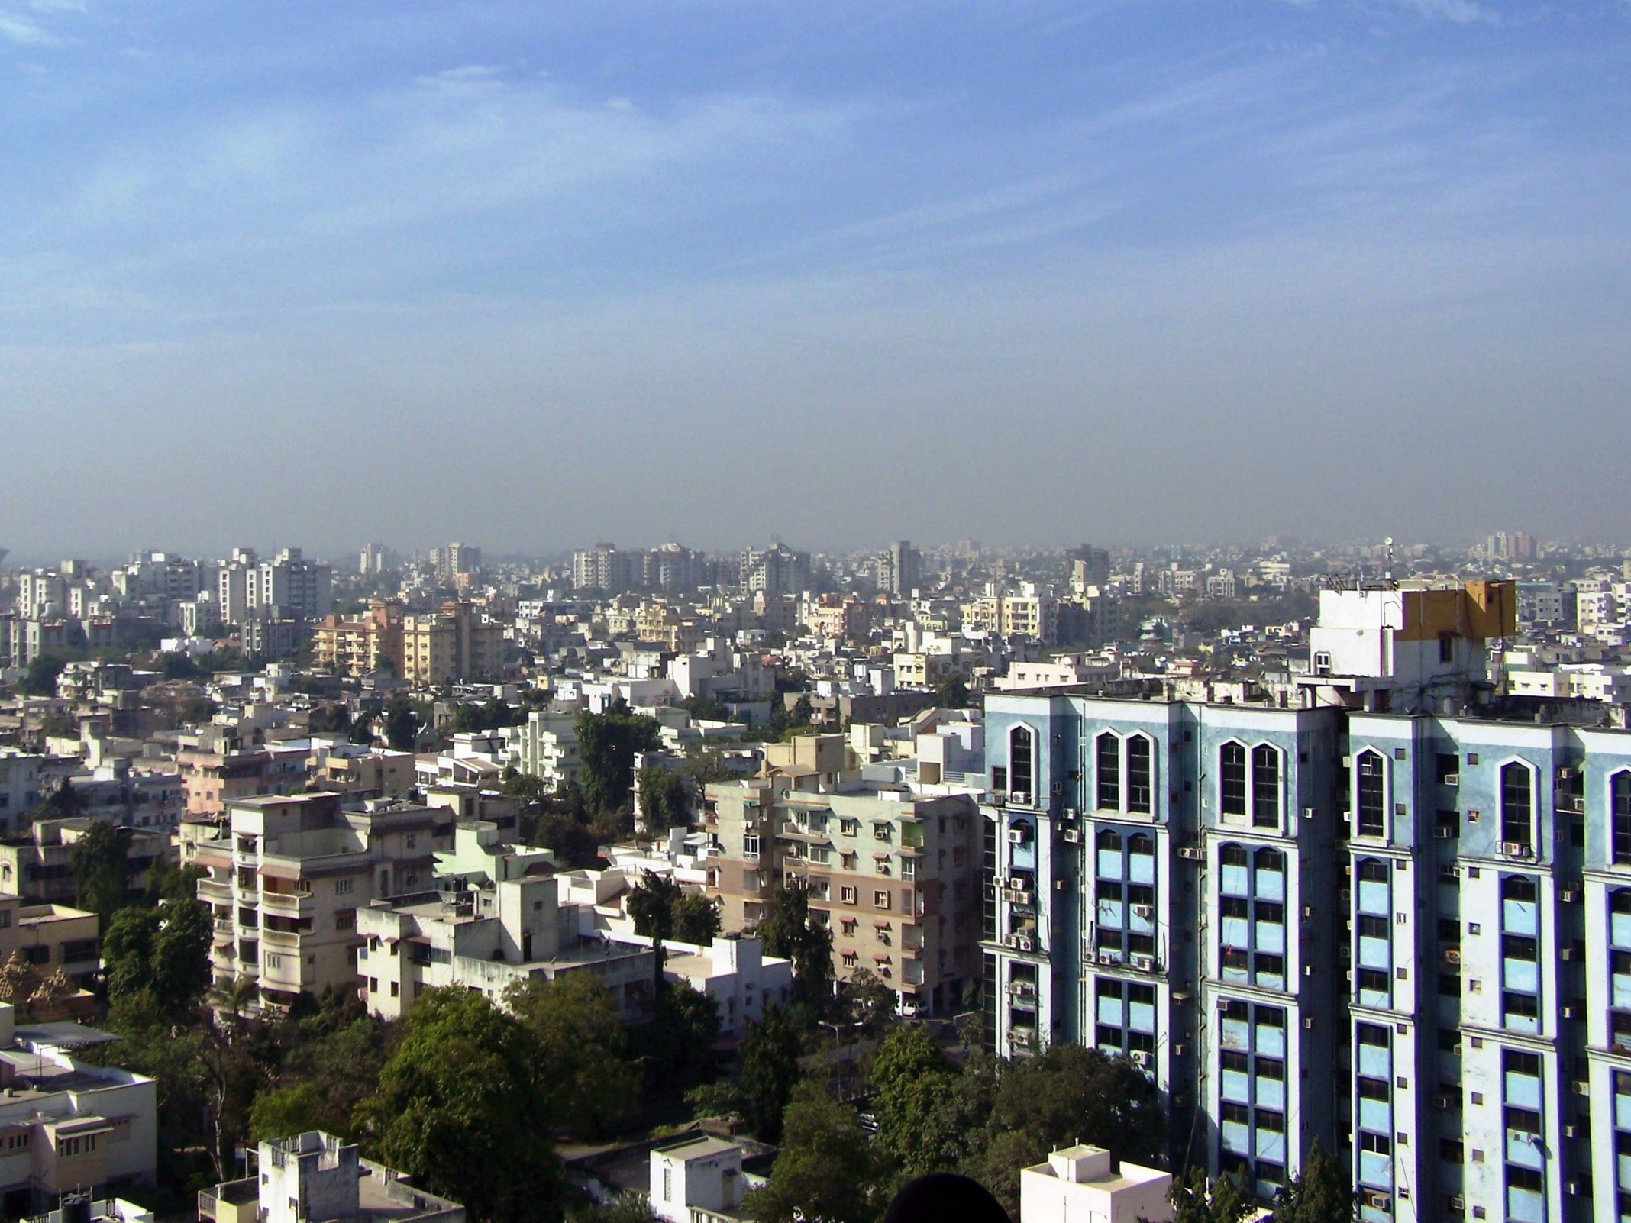
What happened to pollution?
The reformed auditing program caused plants to reduce their pollution emissions by 28 percent.
Percent Change in Pollution Emissions Among Audited Firms

Slide 80
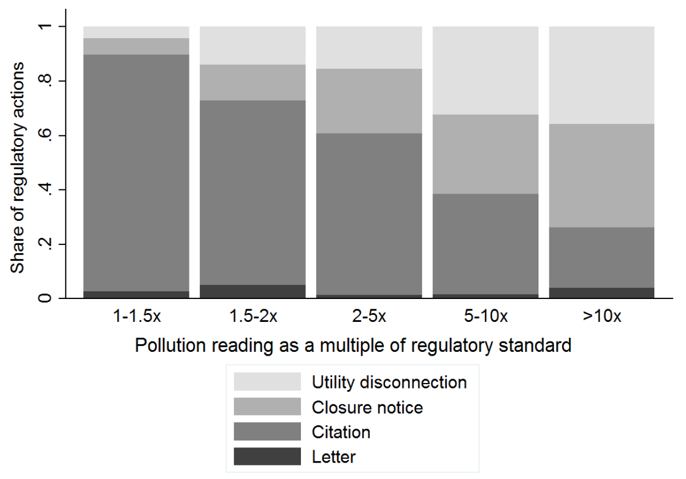
Low Likelihood of Meaningful Punishment

Slide 81
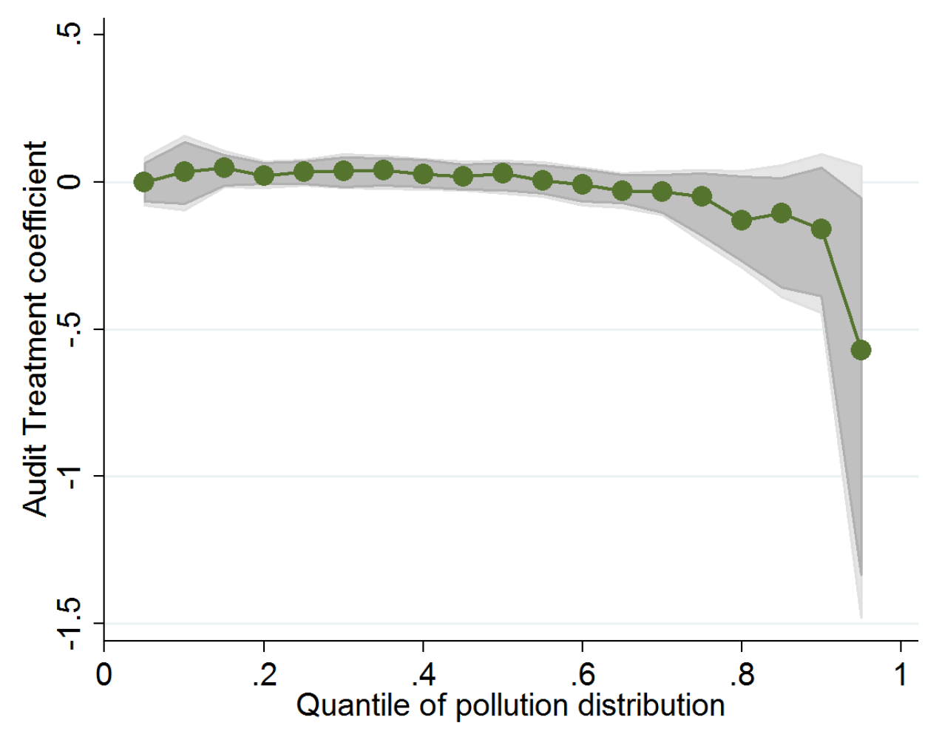
Quantile Regression Effects of Treatment on Endline Pollution

Slide 82
Outline
Environmental regulations have had substantial benefits
Environmental regulations have had substantial costs
Information & incentives are critical for efficiency
Incentivizing the Delivery of Reliable Information to Regulators
The Benefits of Regulatory Discretion
Targeting Inspections
The MIT Solution – “Technology”
Leveraging Citizen Engagement

Slide 83
The Value of Regulatory Discretion: Estimates from Environmental Inspections in India
Econometrica (forthcoming)
Esther Duflo
Michael Greenstone
Rohini Pande
Nicholas Ryan

Slide 84
Government Inspections
Plants are subject to stringent emission limits, with criminal penalties for non-compliance
Inspections are the main way to gather information on pollution
Scientists visit plants and record emissions, then officers decide whether to warn or punish

Slide 85
Methodology
Two-year experiment:
Random variation in inspection frequency (extensive margin)
Observe regulatory process:
Rich intervening data on how process of regulation works (intensive margin)

Slide 86
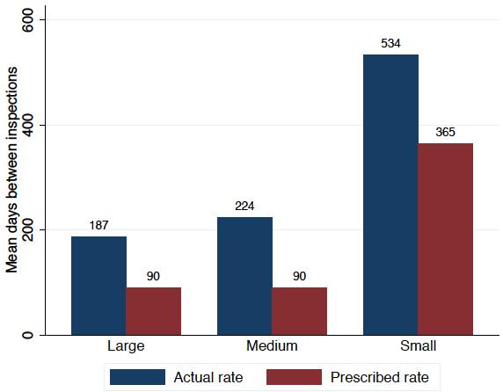
Fewer Actual Inspections than Prescribed, so Lots of Regulatory Discretion
Notes:
Not in the draft
For labor inspections, Prime Minister Modi suggested removing all
discretion and moving to a random schedule of inspection.

Slide 87
Experiment & Control Samples
Sampling:
Sample from the population of 3,455 highest polluting potential firms.
961 plants drawn in two tiers based on audit eligibility:
All 473 plants eligible for environmental audit in Ahmedabad and Surat
Random 488 non-audit-eligible plants from the population
Treatment:
Assigned to be inspected more often, conditional on region and audit eligibility
Thus, we increased inspections to the prescribed rate and entirely removed discretion
Notes:
See page 8 of the draft for these numbers

Slide 88
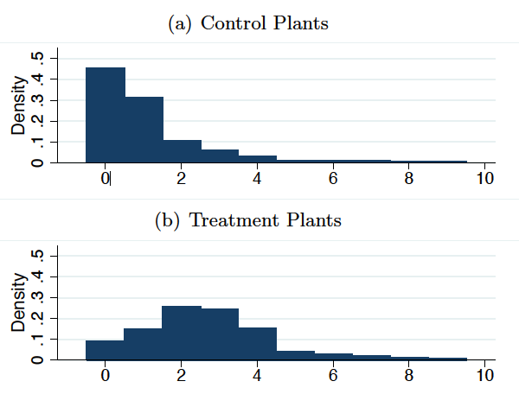
Inspections by Treatment Status
Shift in distribution of inspections for treated vs. control. Mean increase of 1.71 inspections/year
Plants also subjectively perceived a mean increase of 0.71/year in inspections
Notes:
Numbers from page 12 of the draft, figures not in draft

Slide 89
Regulatory Actions by Treatment Status
Notes:
Based on Table 1, Panel C from paper

Slide 90
Firm Response
Notes:
Not in the draft

Slide 91
Endline Pollution and Compliance on Treatment
Notes: Pollution consists of air and water pollution readings for each plant, taken during the endline survey, where each pollutant is standardized by dividing by its standard deviation. Compliance is a dummy for each pollutant being below its regulatory standard.
Notes:
From Table 2, Panel B in the draft

Slide 92
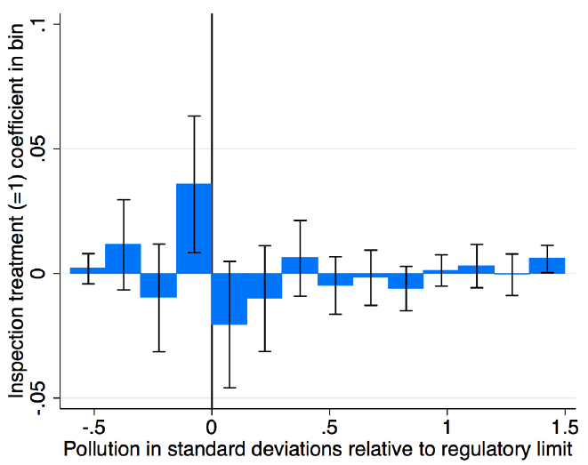
Compliance from Marginal Plants
Compliance increased modestly, by 2.4%
Notes:
Not in the draft

Slide 93
Reduced Form Results - A Puzzle
Firms are inspected more
But not punished more harshly
Not because firms have cleaned up their act:
Some more cheap action (maintenance)
No more costly action (equipment installation)
Some decrease in pollution for plants close to the regulatory threshold
No decline at the larger level of pollution (in contrast to the audit results)
Notes:
Slide 18 table

Slide 94
Possible Interpretations
Regulator does not use the information against plants
This does not seem to be true, since we do observe costly punishment, and also costly abatement measures. Just no more in the treatment.

Slide 95
Possible Interpretations
Regulator does not use the information against plants
This does not seem to be true, since we do observe costly punishment, and also costly abatement measures. Just no more in the treatment.
Additional inspections were systematically ignored
This does not seem to be true, as the additional inspections were entered into the system

Slide 96
Possible Interpretations
Regulator does not use the information against plants
This does not seem to be true, since we do observe costly punishment, and also costly abatement measures. Just no more in the treatment.
Additional inspections were systematically ignored
This does not seem to be true, as the additional inspections were entered into the system
The information collected in the additional inspections was different than that of the average inspection.
This is the hypothesis we will explore now

Slide 97
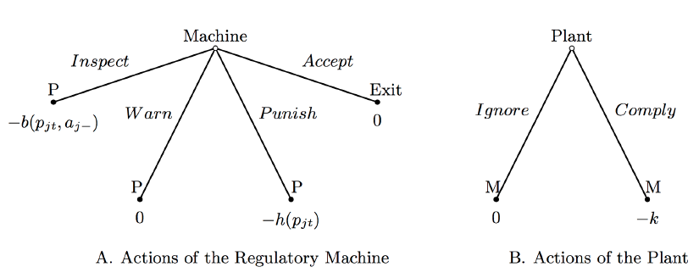
Structural Model
Proceed with a dynamic game model of regulatory costs, inspector behavior, and plant responses
Regulatory machine can inspect, warn, punish, or accept
Plant can ignore or comply
Notes:
Fig 6, slide 27

Slide 98
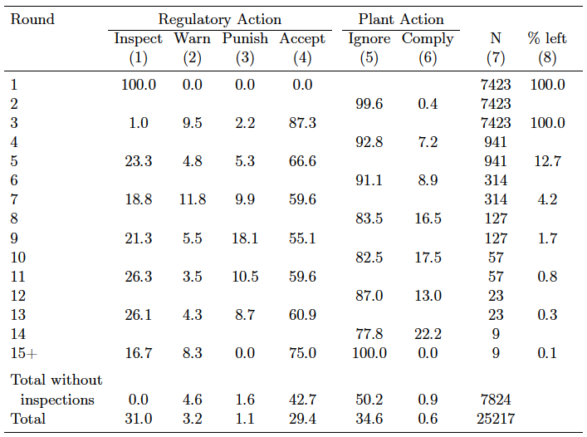
Structure of Penalty Stage Actions
Notes:
Table 3 in draft

Slide 99
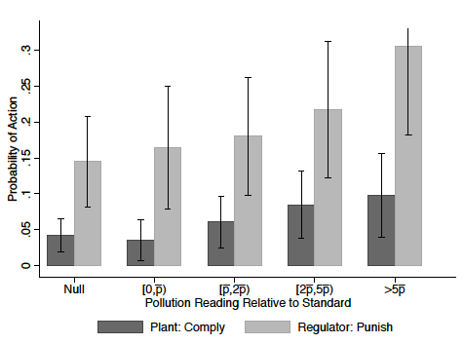
Compliance and Punishment
Regulator punishes plant in high-pollution states, and plant complies when pollution is high. This figure shows the predicted probabilities of compliance and punishment.
Notes:
Not in the draft

Slide 100
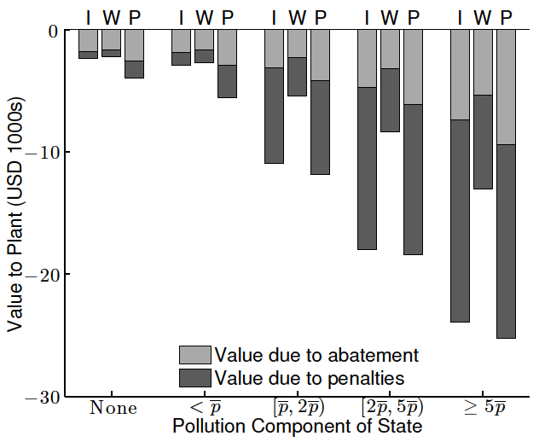
Cost of Environmental Regulation for Regulated Plants (t=6)
Notes:
Figure 4A in draft

Slide 101
Regulatory Penalties Significant in Context
Regulatory penalties consistent with loss of profits
Mean plant annual sales are US $2.9 million
Mean penalty of 24.5 days closure
Assuming 10% profit margin and no substitution, loss of profits of US $20,000
Expected value of penalties much lower
Conditional on initial inspection, E[V(p) | t = 2] = -$2,131.
Regulatory process means punishment is remote
Notes:
$2.9 million, 24.5 days, $20,000 are from middle of page 12 of the draft
-$2,131 is from middle of page 8 of the draft

Slide 102
Conclusions for Regulation Efficacy
Higher inspection frequency leads to modest costs and modest compliance impacts for plants near the margin
High polluters engage in lengthy interaction with regulator and very high polluters are penalized
Cost of penalties 40% of the total cost of regulation
Yet, response seems weak
Notes:
40% number is from middle of page 28 of the draft

Slide 103
Conclusions for Regulation Efficacy
Why is the regulatory response weak?
Large, but distant, penalties
Due to the costly screening of plants
Some evidence for regulatory targeting:
Control inspections yield more penalties than treatment
Alternatively, may be due to diminishing returns to inspections, given penalty regime
We incorporate the regulator’s inability to perfectly observe pollution into the game between them and the plant….

Slide 104
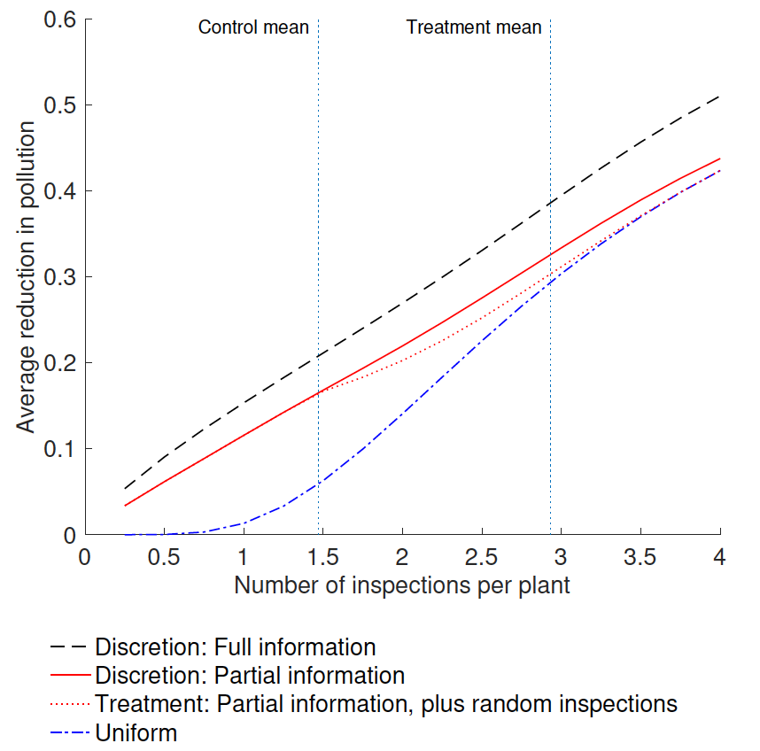
The Value of Discretion: Counterfactual Pollution Abatement by Targeting Regime
Notes:
Figure 8 from draft

Slide 105
Conclusions from 2 Gujarat Studies
Resolving conflict of interest in audit system improved information flows and induced heavy polluters to cut pollution
Introducing rule-based inspector assignment in a system with costly penalties increases social cost with limited gains in terms of pollution compliance
The poor information environment greatly undermines the regulator’s effectiveness.
Little justification for purely random inspection
The problem seems more complex than plain corruption explanation

Slide 106
Outline
Environmental regulations have had substantial benefits
Environmental regulations have had substantial costs
Information & incentives are critical for efficiency
Incentivizing the Delivery of Reliable Information to Regulators
The Benefits of Regulatory Discretion
Targeting Inspections
The MIT Solution – “Technology”
Leveraging Citizen Engagement

Slide 107
Woman vs. Machine: Improving EPA Regulatory Compliance with Machine Learning
In progress
Michael Greenstone
Katherine Meckel

Slide 108
EPA Inspections
EPA only has resources to annually inspect 2% of regulated facilities for violations of the Resource and Recovery Act (1976)
With a machine learning (ML) predictive model, determine the best way to target facilities given data on 10,000 variables
National Field Test in 2017 with the EPA, reducing the cost of enforcing regulations

Slide 109
Are inspections properly targeted?
Over 2005-2015, only 2% of plants were inspected per year
68% of inspections found violations
39% of inspections found severe violations
With only 2% of plants inspected, what was the true number of violating plants?
?

Slide 110
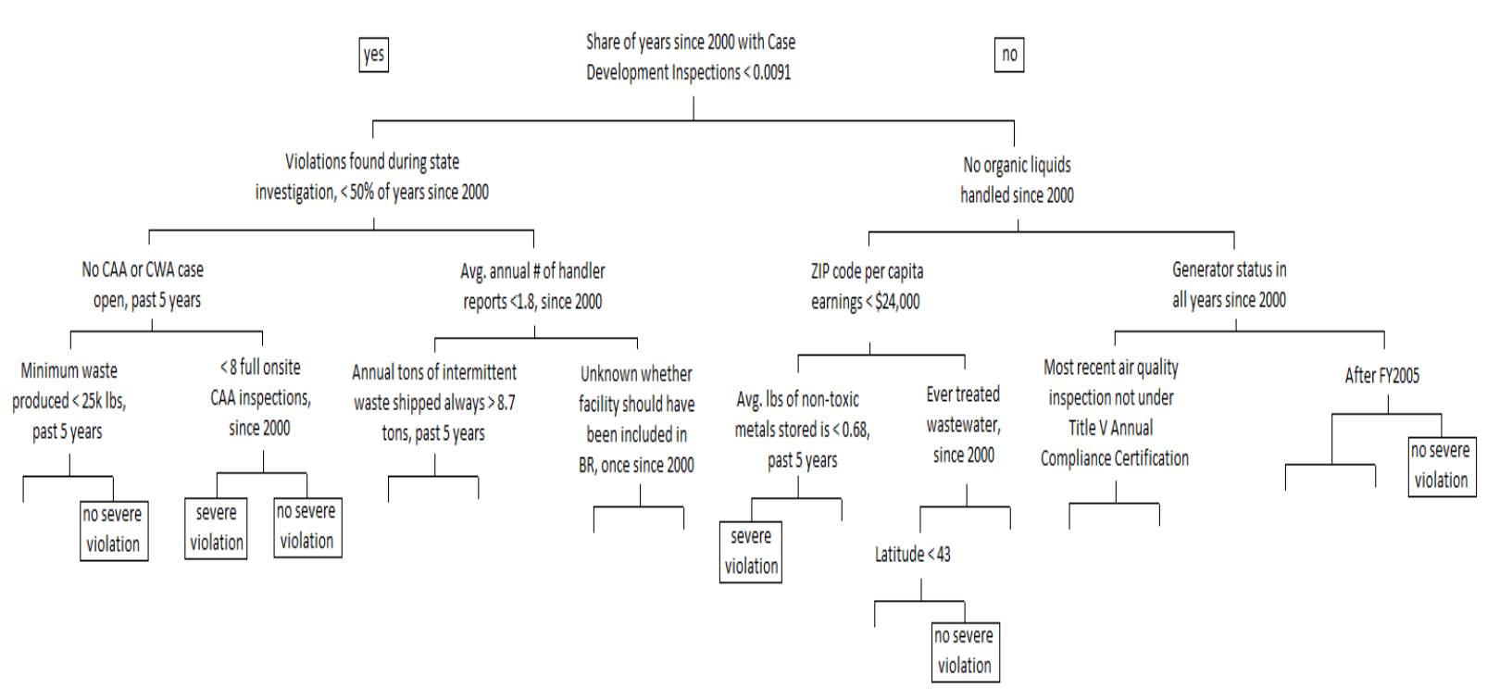
Machine learning method
Random forests: average over many decision trees
Example:

Slide 111
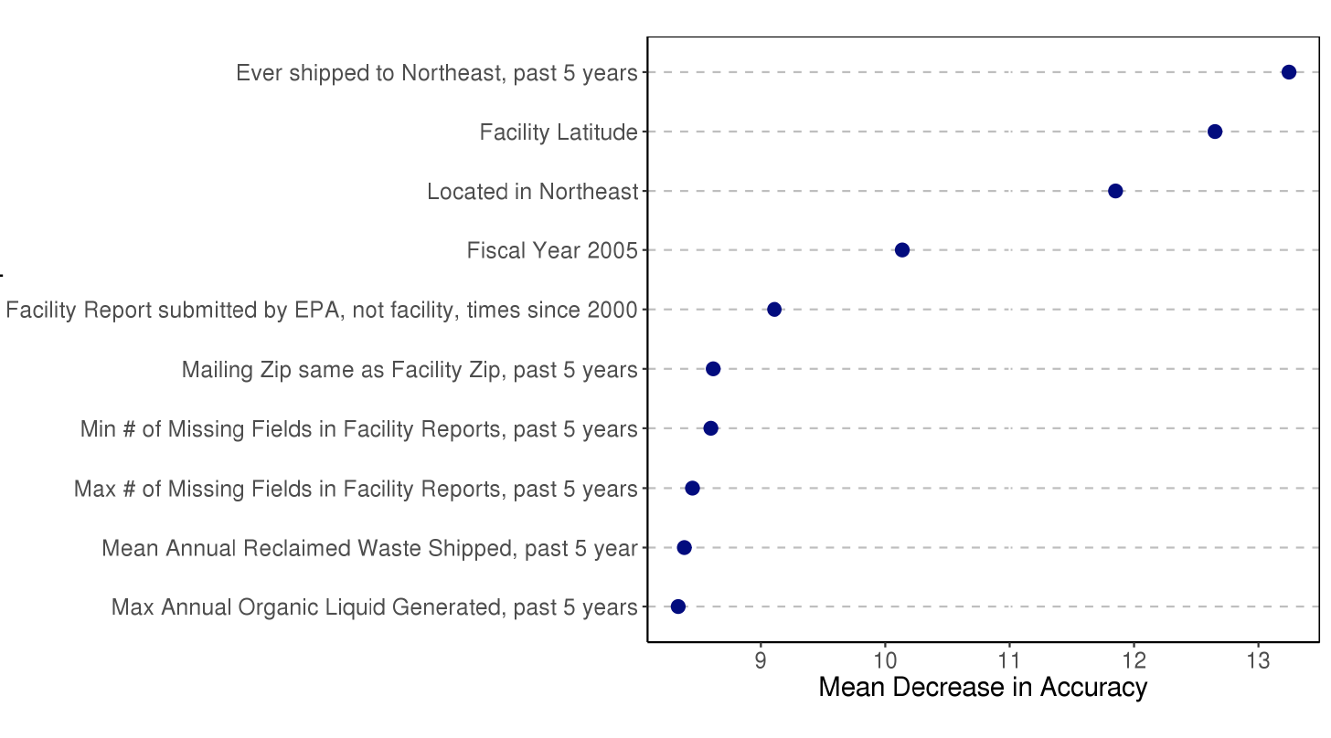
ML Model 10 Top Variables

Slide 112
Preliminary Results
Our model’s inspections uncover 47.4% more violations than the EPA’s
Estimates range from 38% to 56%
Preliminary estimates from field test suggest that the model is doing even better

Slide 113
Outline
Environmental regulations have had substantial benefits
Environmental regulations have had substantial costs
Information & incentives are critical for efficiency
Incentivizing the Delivery of Reliable Information to Regulators
The Benefits of Regulatory Discretion
Targeting Inspections
The MIT Solution – “Technology”
Leveraging Citizen Engagement

Slide 114
Is Technology a Solution? Evaluating the Impacts of Providing Reliable Emissions Information to Environmental Regulators
In progress
Michael Greenstone
Rohini Pande
Nicholas Ryan
Anant Sudarshan

Slide 115
Does better information improve environmental regulation?
Minute-by-minute readings
Online access
Better quality of information through Continuous Emissions Monitoring
Improved accuracy
Lower pollution levels
More regulatory actions
Improved regulation
Lower compliance costs
CEMS

Slide 116
CEMS - Several years in the making
2014
2016
Survey of 1000 industries across Gujarat, Maharashtra and Tamil Nadu
Identification of sample (373 industries) in Surat for emissions trading
2013
Worked with CPCB to prepare technical specifications for the use of CEMS to monitor industrial PM emissions
2015
Identification of suitable hardware and software vendors to form the Data Acquisition and Handling System
Establishment of pilot Data Acquisition and Handling Center in Surat
Preparation of draft market design document
Survey of 270 industries across Surat
Installation of CEMS devices in 135 industries

Slide 117
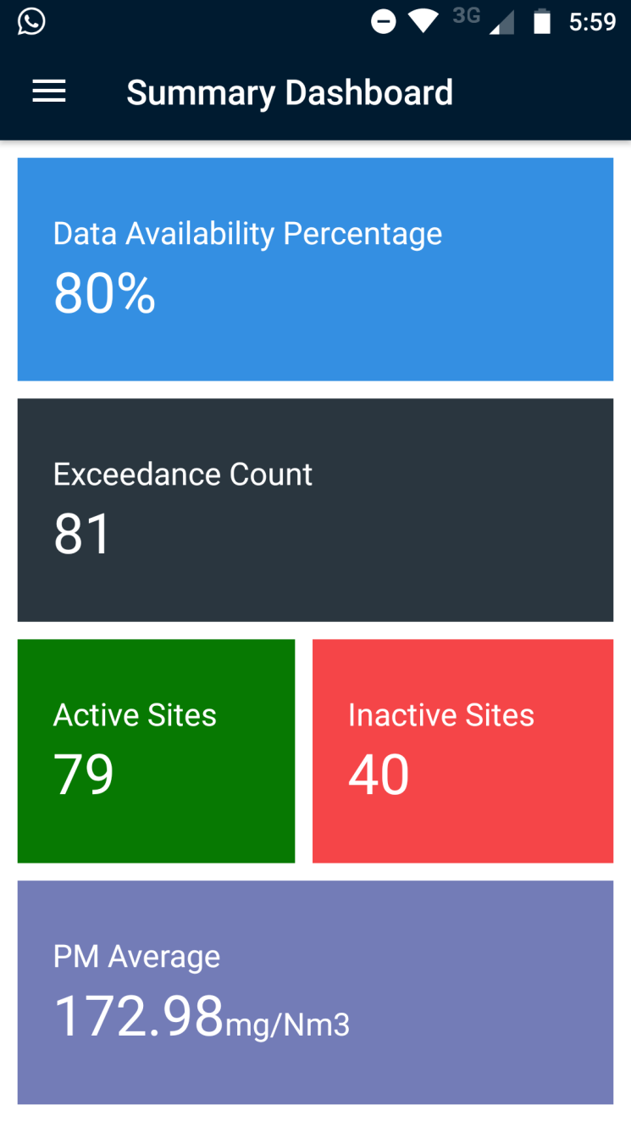
Regulatory use of CEMS data and RCT
Interactive online application (see right)
Regulator has CEMS division to link pollution readings to inspection
Randomized Roll-out and Evaluation of Impacts on Pollution Emissions and Violations

Slide 118
Outline
Environmental regulations have had substantial benefits
Environmental regulations have had substantial costs
Information & incentives are critical for efficiency
Incentivizing the Delivery of Reliable Information to Regulators
The Benefits of Regulatory Discretion
Targeting Inspections
The MIT Solution – “Technology”
Leveraging Citizen Engagement

Slide 119
Can the Public Police Polluters? Evaluating the Impacts of a Pollution Information Disclosure Program in India
In progress
Michael Greenstone
Rohini Pande
Nicholas Ryan
Anant Sudarshan

Slide 120
Maharashtra Star-Rating Program
Disseminates pollution compliance information in an easy-to-understand manner, and allow for comparative performance within and across industries
Goal is transparency, for the public and for industry
Similar to the Toxic Release Inventory (TRI) in the US
We believe that this is the first experimental evaluation of a public information program

Slide 121





Star-Rating Method
Rating based on median PM concentration of the four most recent stack exhaust samples
Rating | Range of PM emissions Median |  | Rating Key | Representation
 | Minimum | Maximum
5 star | 0 | 50 | Very Good
4 star | 50 | 100 | Good
3 star | 100 | 150 | Moderate
2 star | 150 | 250 | Poor
1 star | 250 and above |  | Very Poor

Slide 122
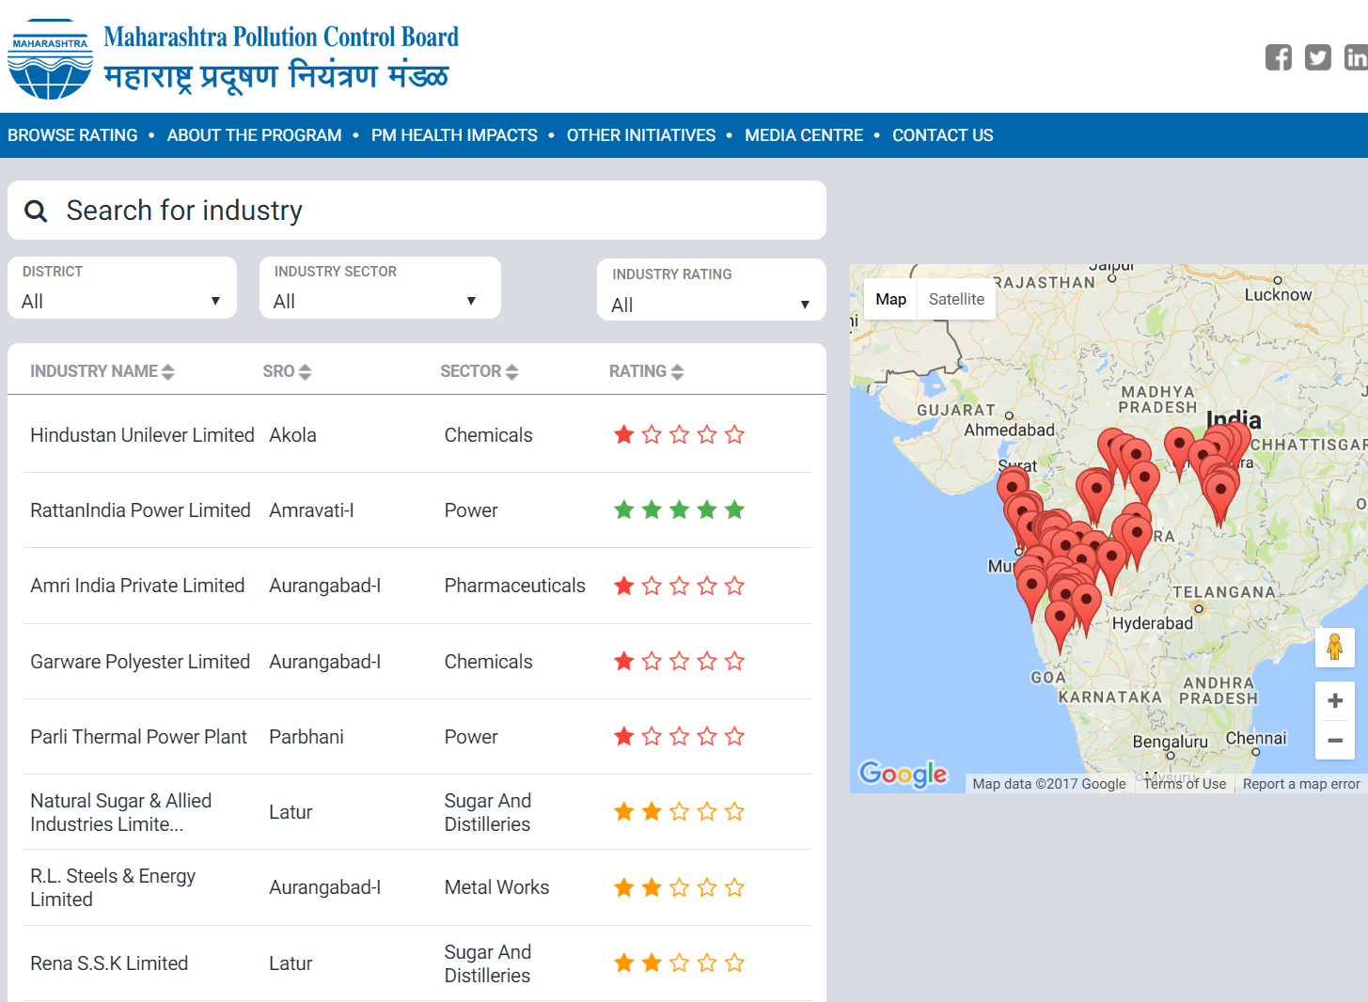
Website Example

Slide 124
Stakeholder Responses
Industries: “The Star Rating program is a very good practice which will show performance of air emission compliance by industries. This is an excellent initiative by the MPCB.” “The star rating program will be helpful to control the air pollution from industries.” “Transparency in rating procedure and publication. This is a fantastic attempt at quantitative benchmarking.” “Industries with good infrastructure and practices regarding air pollution can be motivated to improve, and we will have to plan for the same” | Media: Economic Times: Maharashtra starts industry rating to check emissions Bloomberg: Indian State Introduces First Emissions Rating System for Factories Hindustan Times: Study identifies 23 most polluting industries in Maharashtra India Climate Dialogue: What are you breathing today in Maharashtra? Business Standard: Maharashtra starts industry rating to check emissions

Slide 125
Existing Work - Enforcement
Policy loopholes undermine effectiveness of environmental regulations
Davis (2008) – Policy loopholes undermine driving restrictions’ effectiveness in Mexico City
Oliva (2015) – Corruption and bribes undermine effectiveness of environmental regulations
Inefficient incentives and rent-seeking behavior by politicians can harm environmental quality
Burgess et al. (2012) – Increases in the number of political jurisdictions increases the rate of deforestation
Lipscomb and Mobarak (2017) – Decentralization results in increased water pollution

Slide 126
Main Takeaways
Environmental regulations have had substantial benefits
Environmental regulations have had substantial costs
Information & incentives are critical for efficiency
We know a great deal about how to optimally choose regulations
But, costs and benefits critically depend on information and incentives
Much future work is necessary, both in particular settings and with the aim of uncovering general lessons

